Slide 1

Organization Culture - Characteristics and Importance.
Understanding the Foundation of Workplace Behavior
Team: Group 3
Abhay Raj
Shubhabas Patra
Alok Ranjan
Yakshit Israni
Harsh Pandey

Slide 2
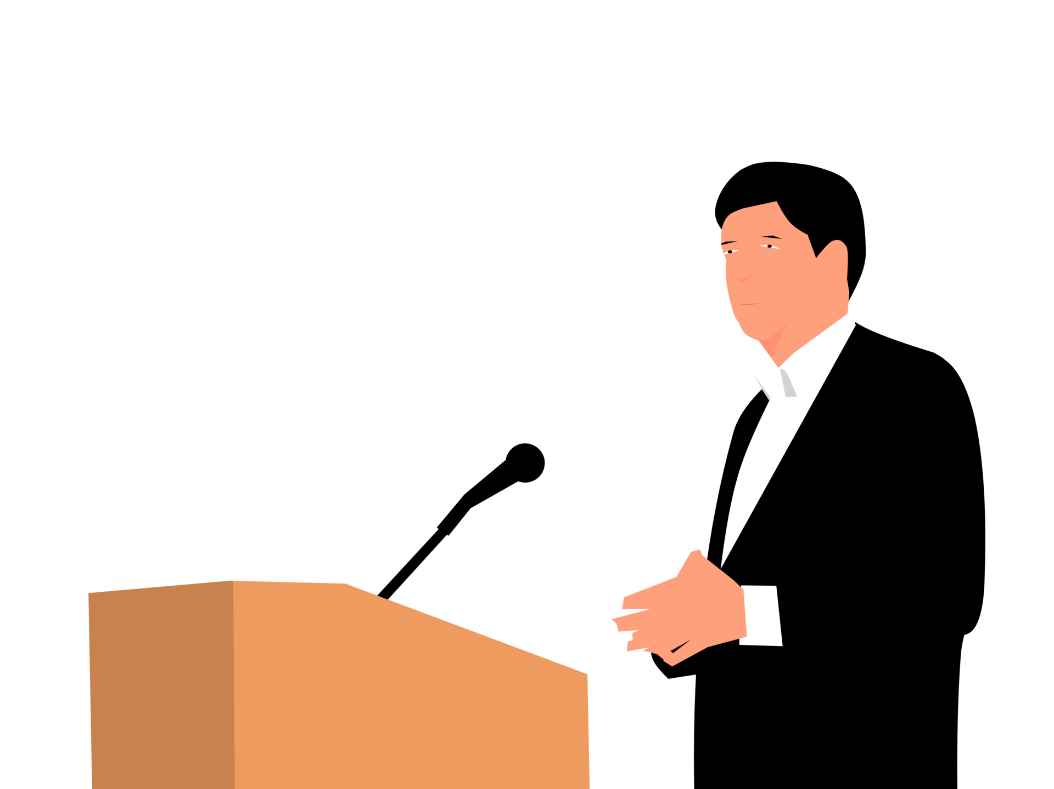
Introduction

Slide 3
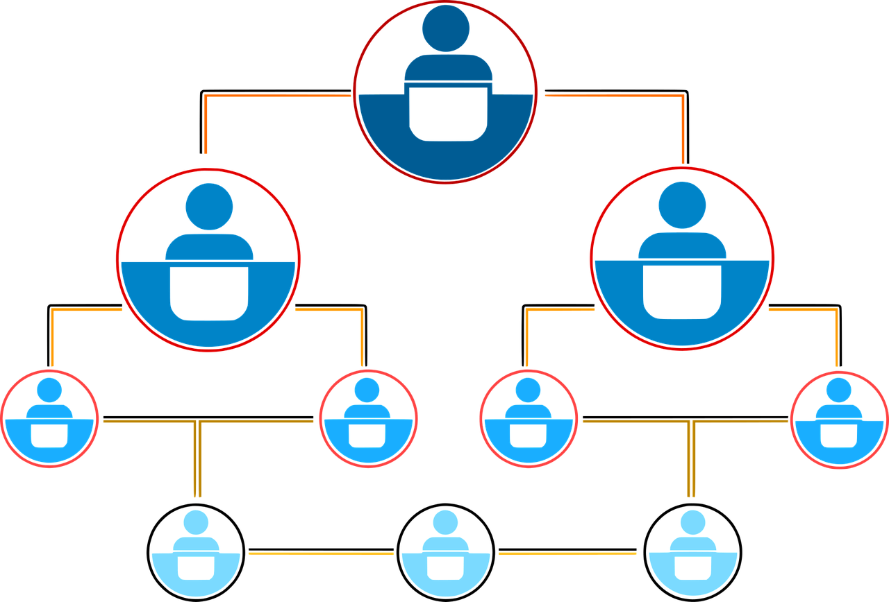
What is an Organization?
Organization refers to a collection of people, who are involved in pursuing defined objectives.

Slide 4

Let’s Think About This...
What makes a company unique beyond its products or services?
Why do some workplaces feel welcoming while others don’t?
Have you ever noticed a difference in work environment between two organizations?
What does “culture” even mean in a corporate context?

Slide 5

Each of us has a unique personality—traits and characteristics that influence the way we act and interact with others. When we describe someone as warm, open, relaxed, shy, or aggressive, we’re describing personality traits.
An organization, too, has a personality, which we call its culture. And that culture influences the way employees act and interact with others

Slide 6

What is Organizational Culture?
Organizational culture has been described as the shared values, principles, traditions, and ways of doing things that influence the way organizational members act and that distinguish the organization from other organizations.

Slide 7
More About Organizational Culture
Our definition of culture implies three things.
First, culture is a perception.
Second, organizational culture is descriptive.
Lastly, shared aspect of culture.

Slide 8
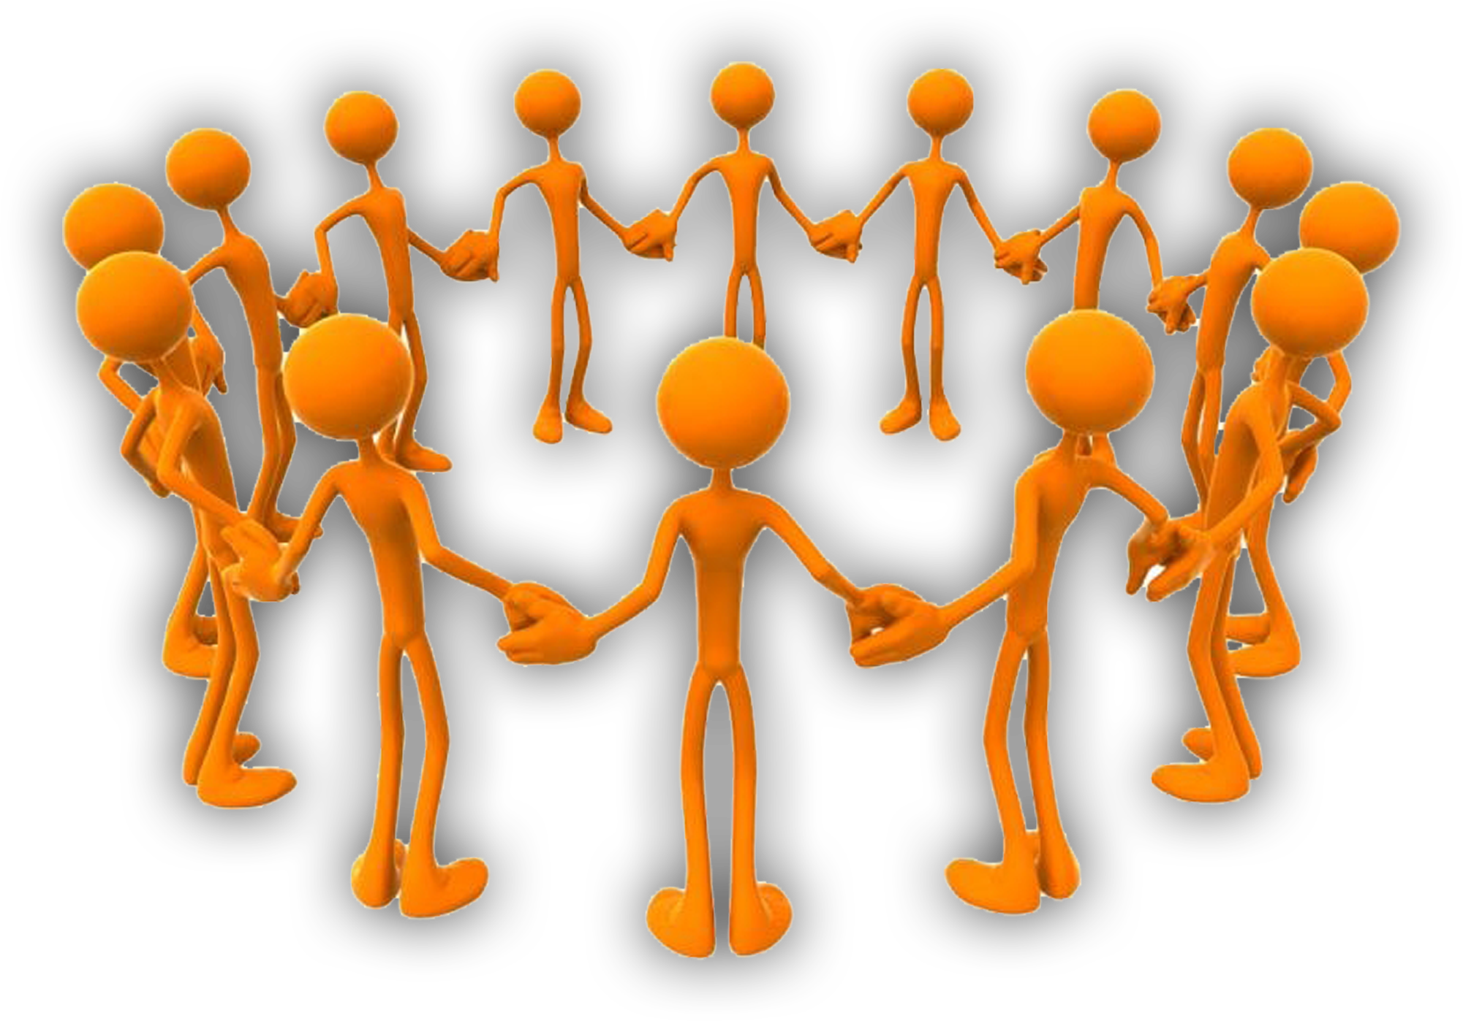
Types of Cultures
All organizations have cultures, but not all cultures equally influence employees’ behaviors and actions.
Strong cultures those in which the key values are deeply held and widely shared have a greater influence on employees than do weaker cultures

Slide 9
Example
Organization A has a rigid, rule-bound culture. Managers avoid risk, prefer data over creativity, and fear failure due to criticism.
Employees are strictly supervised and isolated within departments. Rewards are based more on seniority than performance.
This leads to a weak culture in terms of innovation, adaptability, and employee morale, although it is strong in control and structure.

Slide 10
Example
Organization B, on the other hand, has a flexible, innovation-driven culture.
It encourages risk-taking, values both intuition and logic, and sees failure as a learning opportunity.
Employees work in cross-functional teams, enjoy autonomy, and are rewarded based on outcomes. This reflects a strong, adaptive culture that promotes creativity, collaboration, and high morale.

Slide 11
We can say,
Organization A: Structured but weak in adaptability and employee engagement.
Organization B: Innovative and strong in cultural alignment and motivation.

Slide 12
Building and Learning Organizational Culture

Slide 13
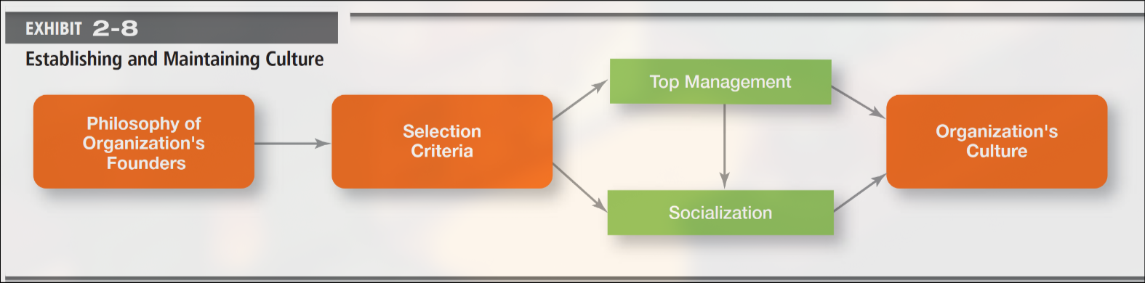
Where Culture Comes From and How It Continues

Slide 14
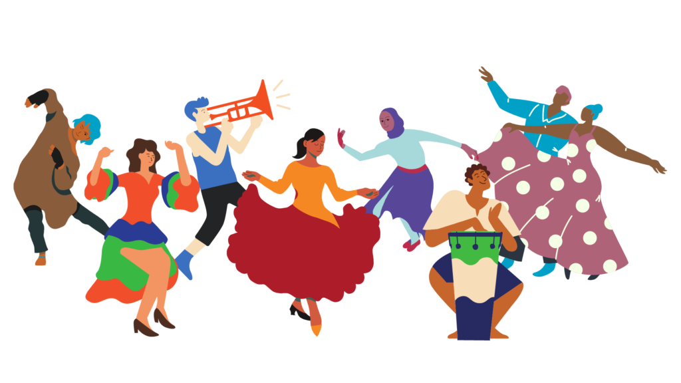
Where Culture Comes From
Founders Set the Foundation
Culture begins with the vision and values of the founders.
Founders like Bill Gore (W. L. Gore) shape culture by setting early standards and practices.
Small organizational size makes it easier to spread this vision.

Slide 15
Where Culture Comes From
Top Managers Reinforce Culture
Leaders influence culture through actions and decisions.
Example: At Best Buy, tours of the "retail hospital" reinforced competitiveness.
At IBM, CEO Sam Palmisano rewarded teamwork from his own bonus.

Slide 16

How Culture Continues
Employee Selection & Fit
New hires are chosen not just for skills, but for cultural fit.
Candidates also evaluate if the culture suits them.

Slide 17
How Culture Continues
Socialization Process
New employees learn behaviors and values through onboarding.
Example: Starbucks baristas undergo 24 hours of training in culture, language, and service.

Slide 18

How Do Employees Learn Organization Culture?
Employees “learn” an organization’s culture in a number of ways. The most common are stories, rituals, material symbols, and language.

Slide 19

STORIES
Employees learn culture through shared stories of success, failure, or heroism.
Eg. There’s the story about the 3M scientist who spilled chemicals on her tennis shoe and came up with Scotchgard. Then, there’s the story about Art Fry, a 3M researcher, who wanted a better way to mark the pages of his church hym-nal and invented the Post-It Note

Slide 20
RITUALS
Rituals reinforce core values through repeated activities.
Eg. At Mary Kay Cosmetics, an annual awards ceremony is held where top salespeople receive rewards like gold pins, diamond jewelry, and pink Cadillacs.

Slide 21
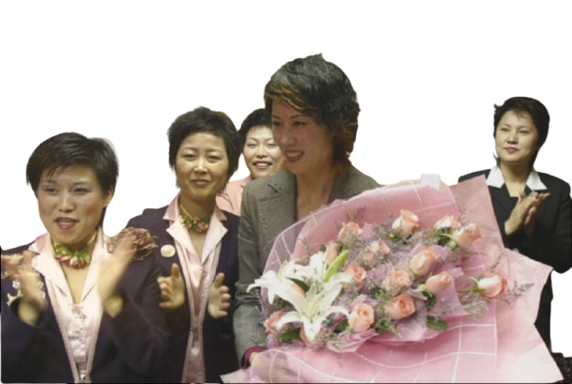
RITUALS
This ritual not only celebrates high performance but also reinforces the company’s values of hard work, determination, and personal success

Slide 22
LANGUAGE
Many organizations and units within organizations use language as a way to identify and unite members of a culture.
By learning this language, members attest to their acceptance of the culture and their willingness to help preserve it.

Slide 23
LANGUAGE
For instance, at
Cranium, a Seattle board game company, “chiff ” is used to remind employees of the need to be incessantly innovative in everything they do. “Chiff ” stands for “clever, high-quality, innovative, friendly, fun.”

Slide 24

Impact of Organizational Culture on Engineering/Tech Companies

Slide 25
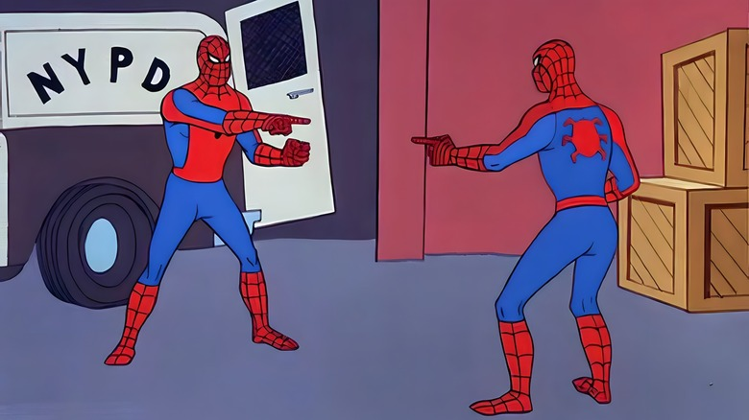
What is Organizational Culture?
It’s the company’s personality—shared values, behaviors, believes.
In tech firms, it shapes how teams innovate, code, and collaborate

Slide 26

Why Culture Matters in Tech?
Culture drives agility, innovation & work-life balance
Strong culture = lower attrition + better code quality
Example: Google vs. Twitter’s cultural shift chaos

Slide 27
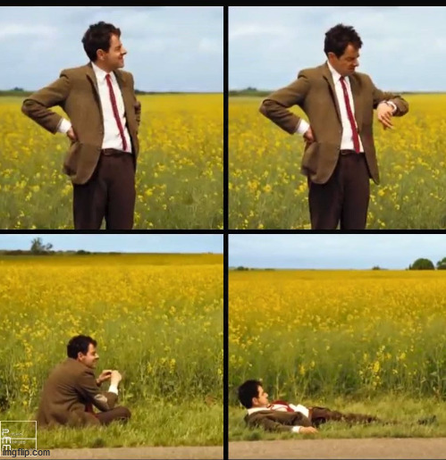
Dimensions of Tech Culture
Trust, risk-taking, autonomy & innovation are key in tech
Global tech firms must consider cultural differences (e.g., Hofstede)

Slide 28

Good Culture = Good Engineering
Psychological safety boosts experimentation & creative coding
Positive culture = fewer bugs, more breakthrough ideas
Example: Atlassian’s “ShipIt Days” unlock creativity.

Slide 29
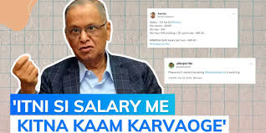
Bad Culture = Burnout & Bugs
Toxic work = stress, high turnover, poor products
Micromanagement kills dev freedom and innovation
Example: 70-hour week debate sparked backlash

Slide 30

HRD Climate & QWL in Tech
HRD (like OCTAPACE) improves learning & teamwork
QWL helps devs feel valued and stay longer
Example: Infosys builds learning culture via mentorship

Slide 31

Conclusion
Organizational culture shapes values, behavior, and performance across the company.
A strong culture drives motivation, innovation, and long-term success.

